Slide 1

Health-Care Management System
Guided By:- Dr. Jignesh Doshi
Developed by
Name | Enrollment
Arnold Macwan | 21004500210065
Tirth Panchal | 21004500210086
Dharmik Halani | 21004500210046

Slide 2

Introduction
A healthcare management system is a software solution designed to optimize various aspects of healthcare delivery and administration. It encompasses tools and processes for managing patient records, scheduling appointments, etc.
This system is instrumental in improving healthcare efficiency, reducing errors, and enhancing the overall quality of patient care.

Slide 3

Problem Statement
A web-based Healthcare Management System , which allows healthcare providers to efficiently manage patient records, appointments, and medical history and also it enables patients to access and interact with their health information.

Slide 4
OBJECTIVE
Main goal of the project is to provide a primary healthcare services and reliable health information to the patients by anywhere at doorstep

Slide 5
Core Components
Admin
Login
User
Login
Reset password
Staff
Login
Patient reports
Staff management
Generate reports & insights
Signup
Scheduling tasks/appointments
Patient history
Home visit scheduling
Feedback & reviews
Profile management
Manage FAQs section
Blog posts
Blog posts
Appointment remainder
Dashboard
Staff records
Health records
Medical report download
Search staff
Manage visit
Delete account
Request home visit
Staff profile management
Reset password
Manage test result
Book tests
Manage medical tests
Task remainder

Slide 6
Advantages & limitations
Advantages
Limitations
Cost of Implementation
Health monitoring by anywhere
Anytime anywhere
Paperless work
Data Security Concerns
Maintenance and Updates

Slide 7
Assumptions : - we assumes that sources or patients provide reliable and trustable health information. - We also assume that sources follow regulations & protection laws on website.
Assumptions & Constraints
Constraints :
- No Backup services
- Supported English language only

Slide 8
Project Profile
Project name |  | Healthcare
Front-end |  | HTML5 ,CSS3, JavaScript, Bootstrap
Back-end | Database | Mongodb
 | Framework | Django

Slide 9
Requirement Determination
Requirement determination for healthcare project involves gathering, analyzing, and documenting the needs and expectations of stakeholders .
This phase is consists of :
Surveys & sampling
Client’s requirements
Identifying the non-functional requirements
Review existing system if available
References
https://www.indimac.in/
https://www.advinohealthcare.com/

Slide 10
Targeted users
Admin
User
Staff
Presentation Title

Slide 11
System design

Slide 12
USE CASE DIAGRAM

Slide 13
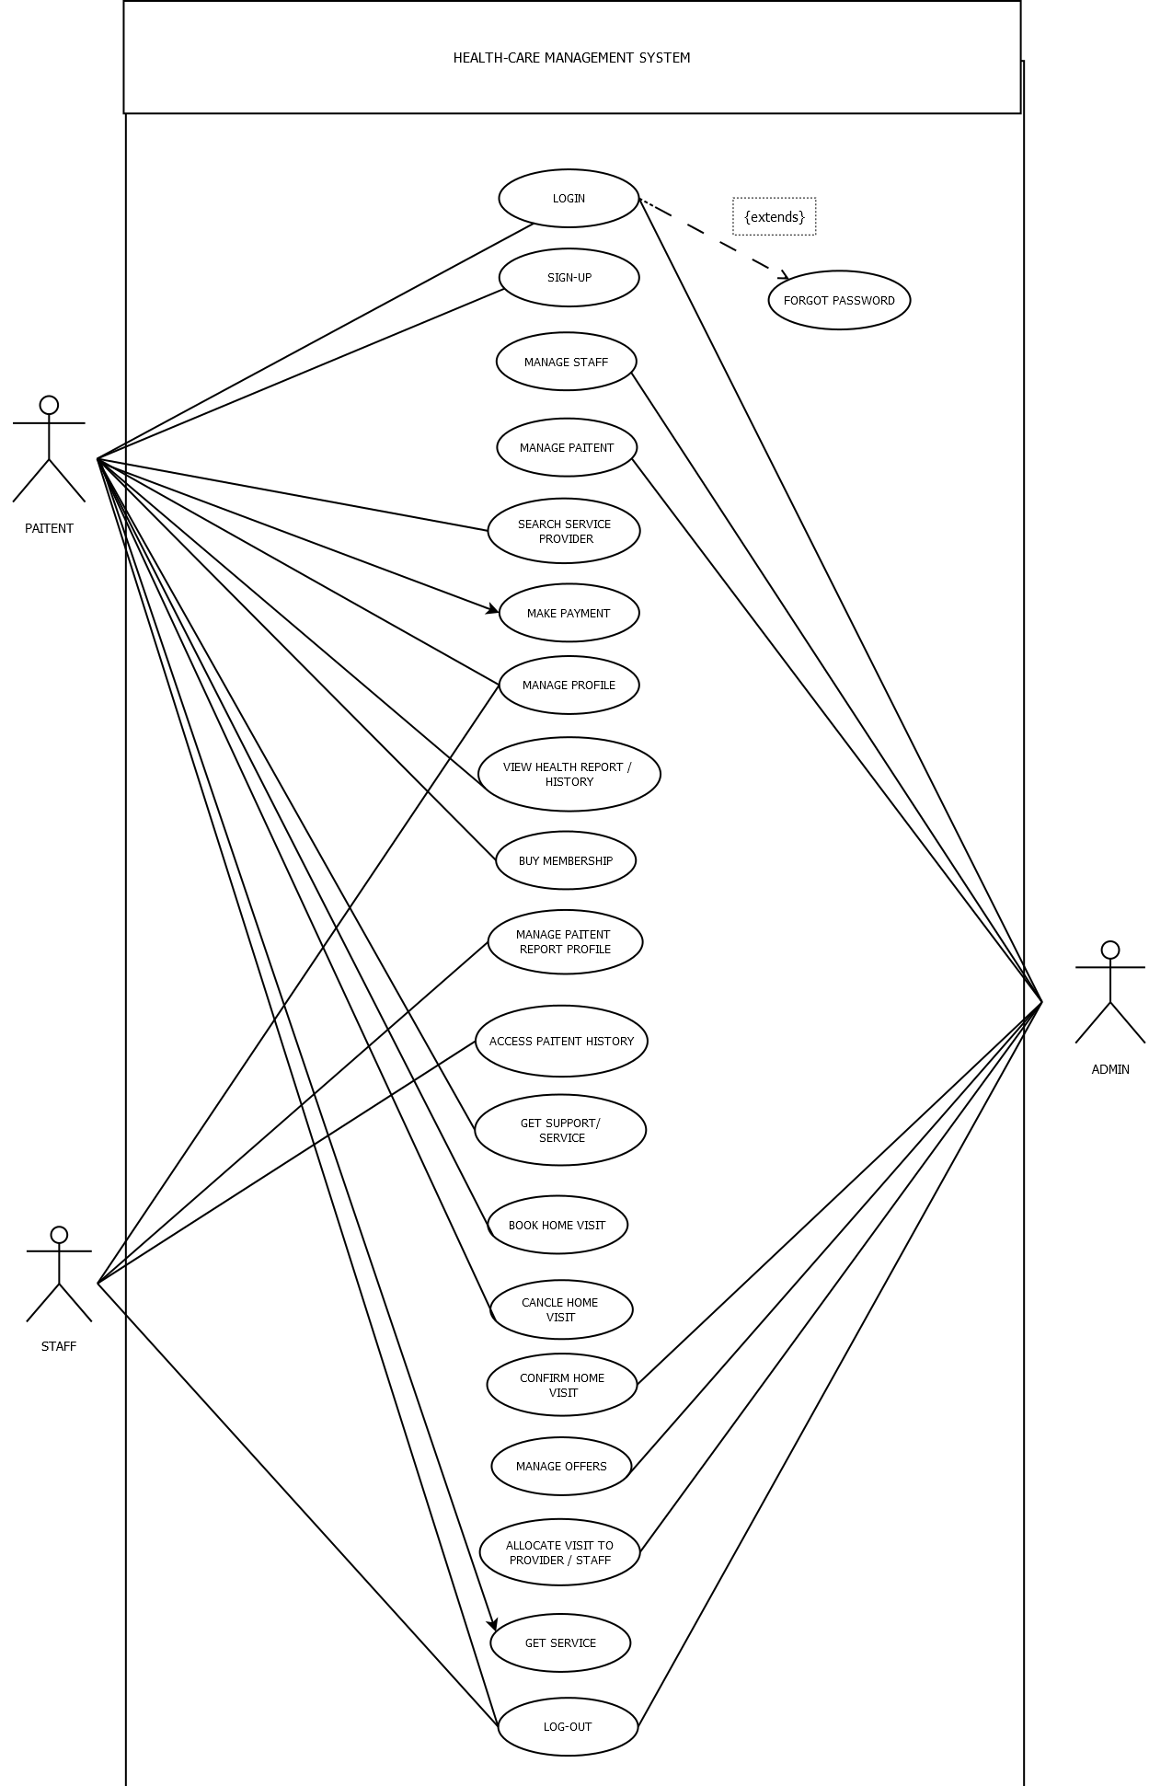

Slide 14
CLASS DIAGRAM

Slide 15
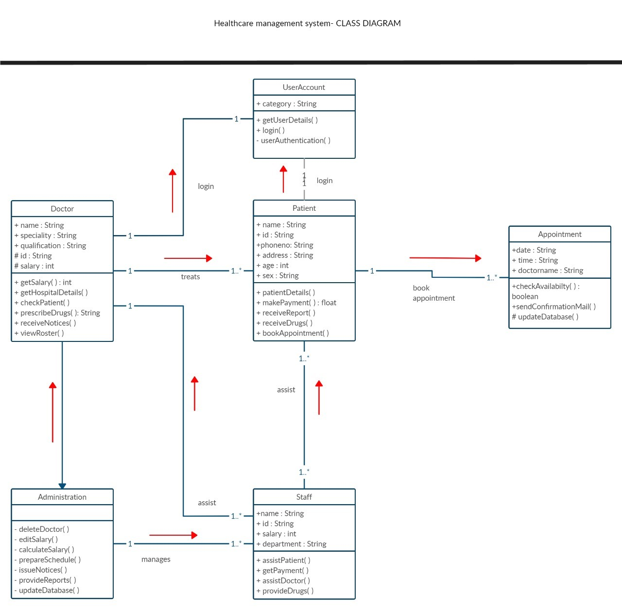

Slide 16
ACTIVITY DIAGRAM

Slide 17
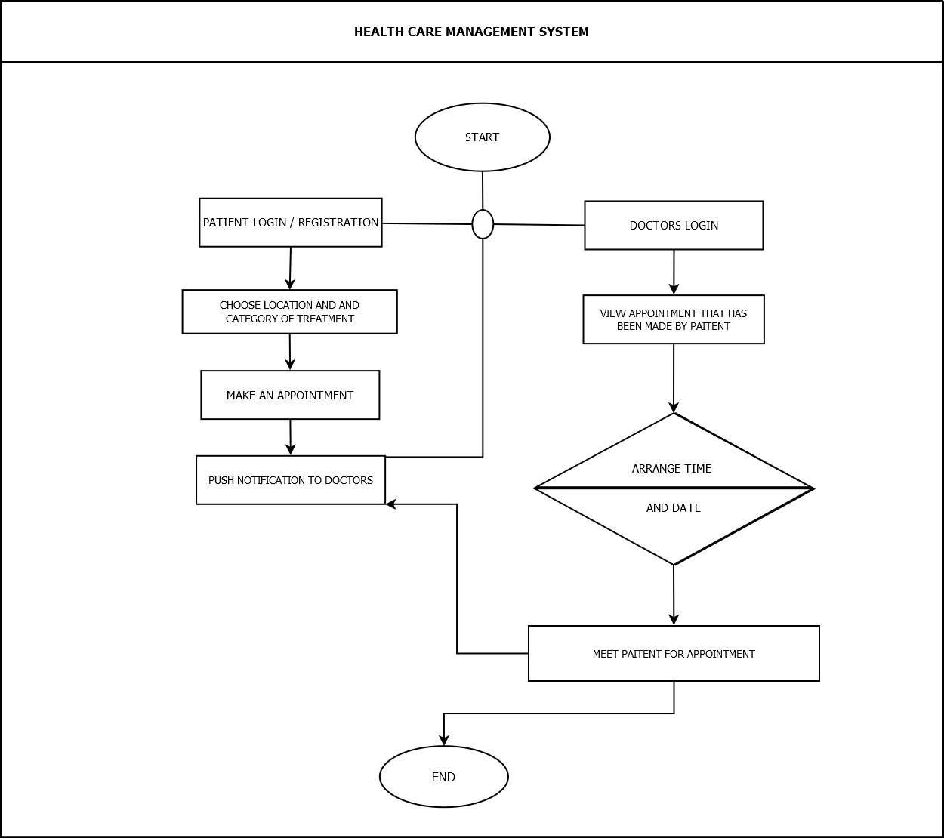

Slide 18
DEVELOPMENT

Slide 19
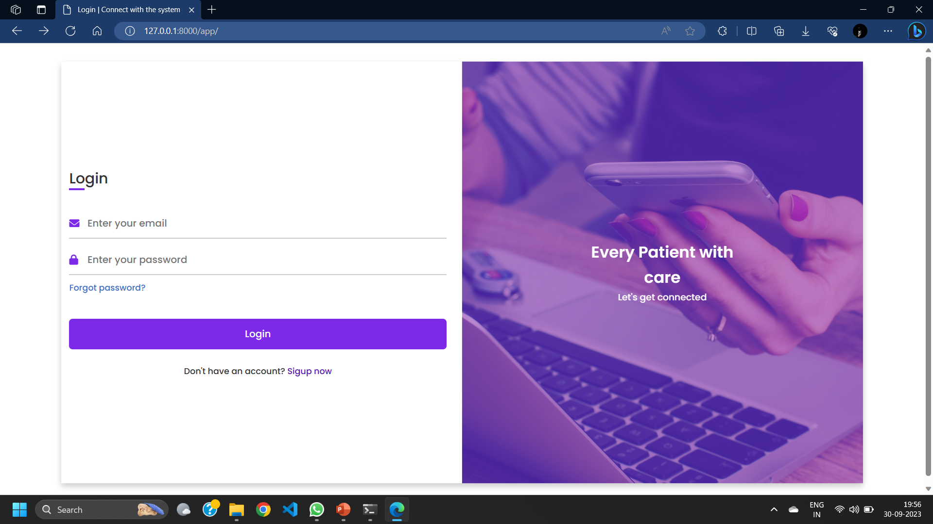
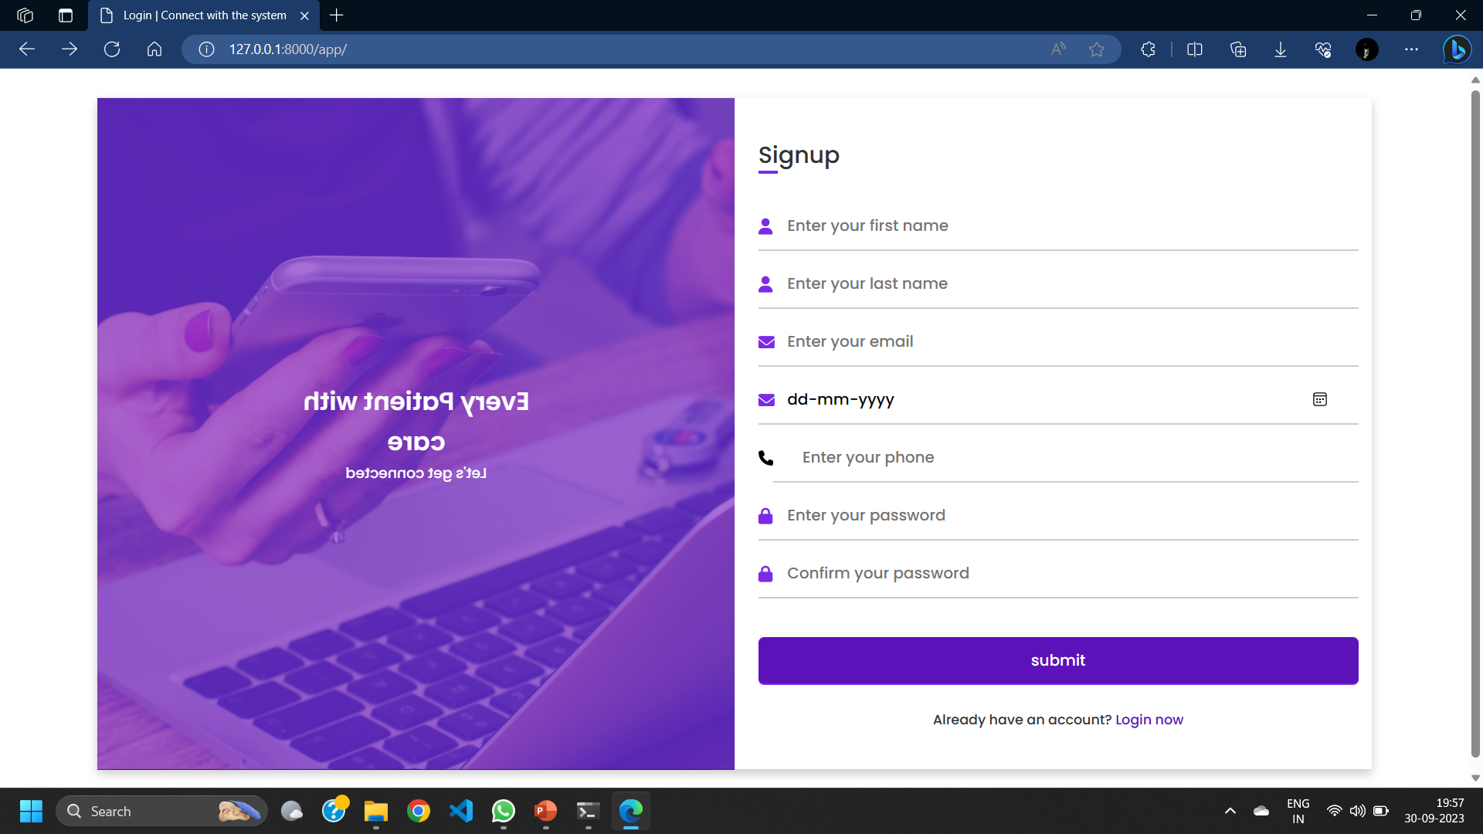
Screenshots

Slide 20
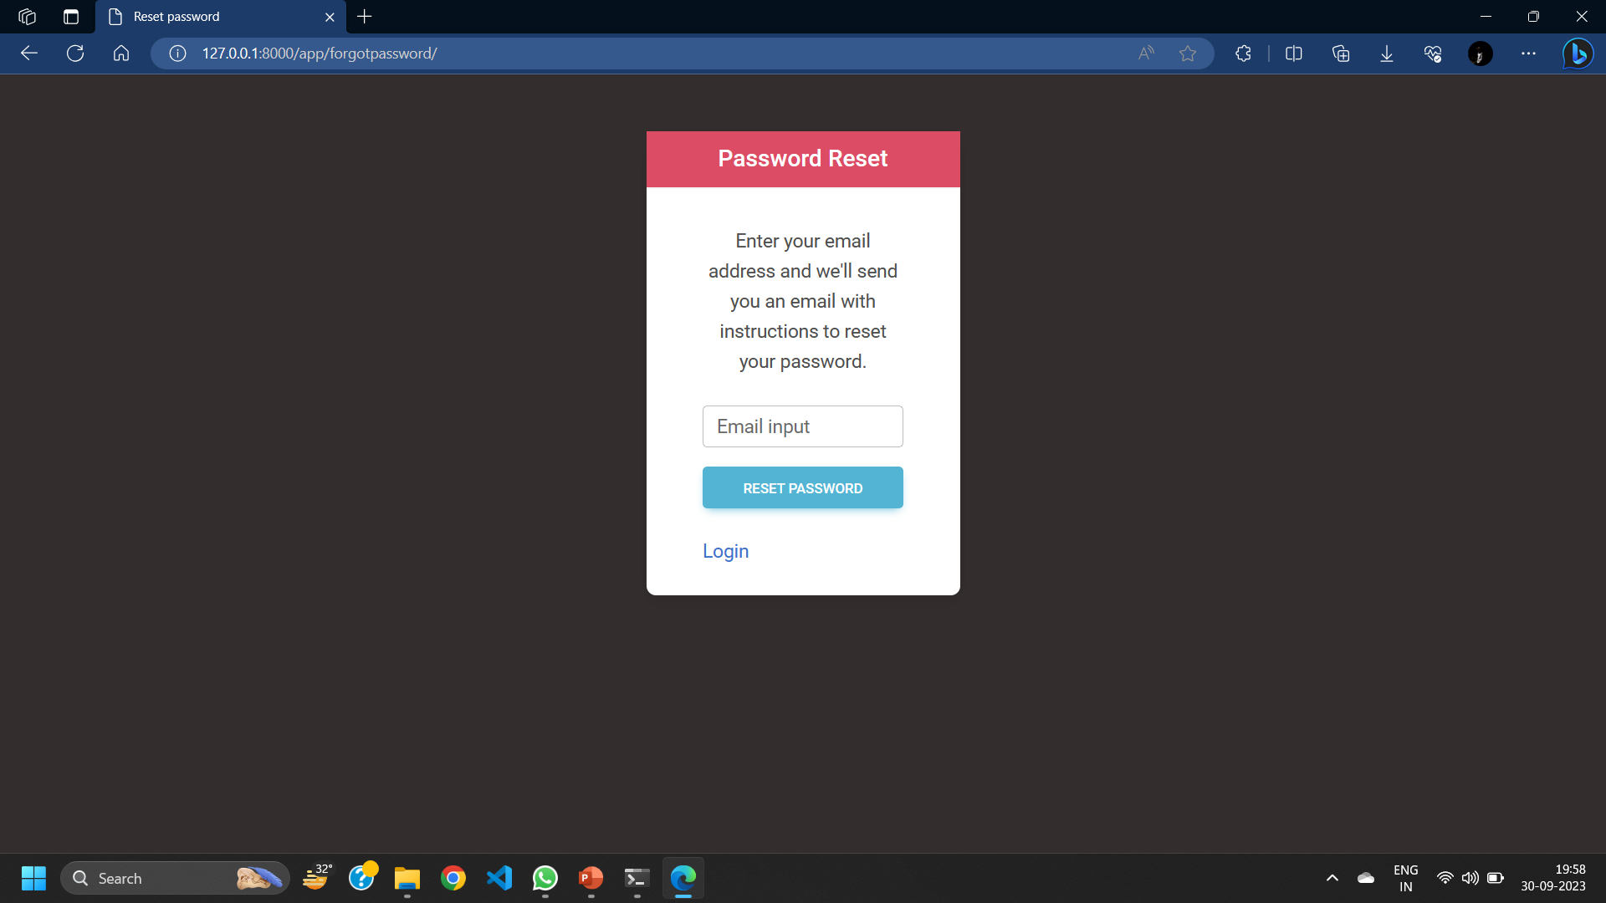
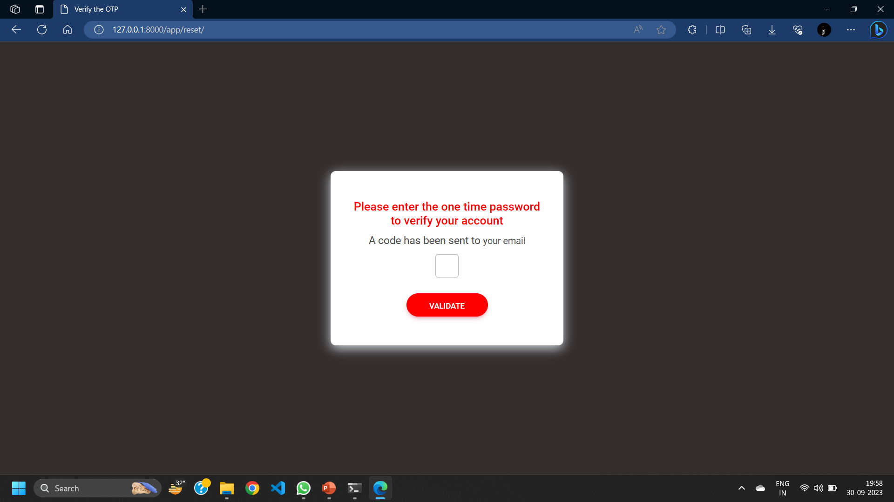

Slide 21
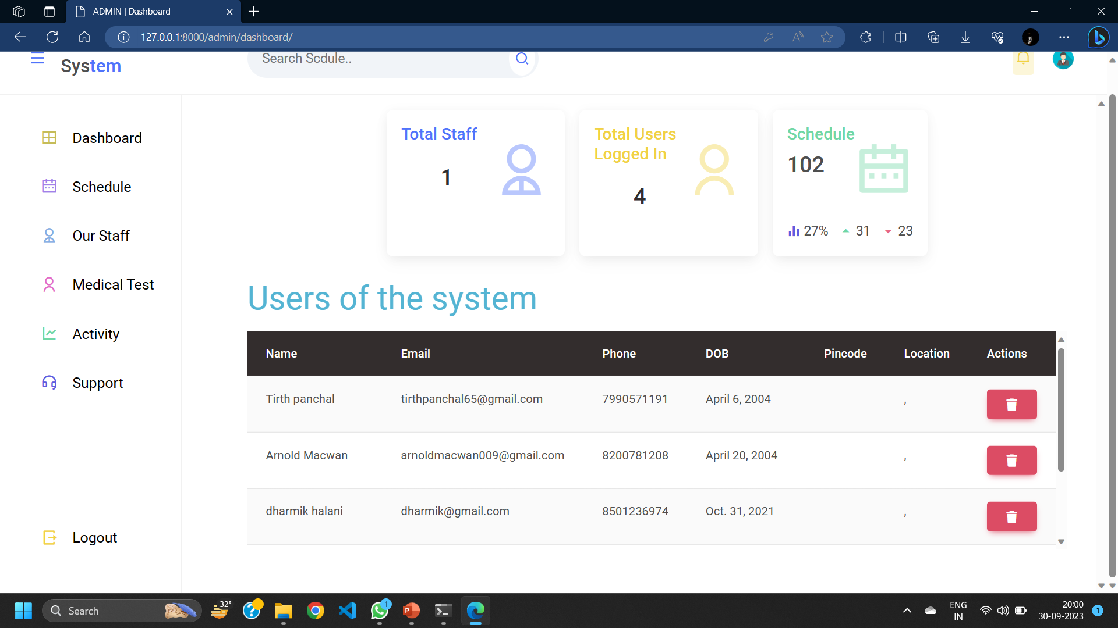

Slide 22
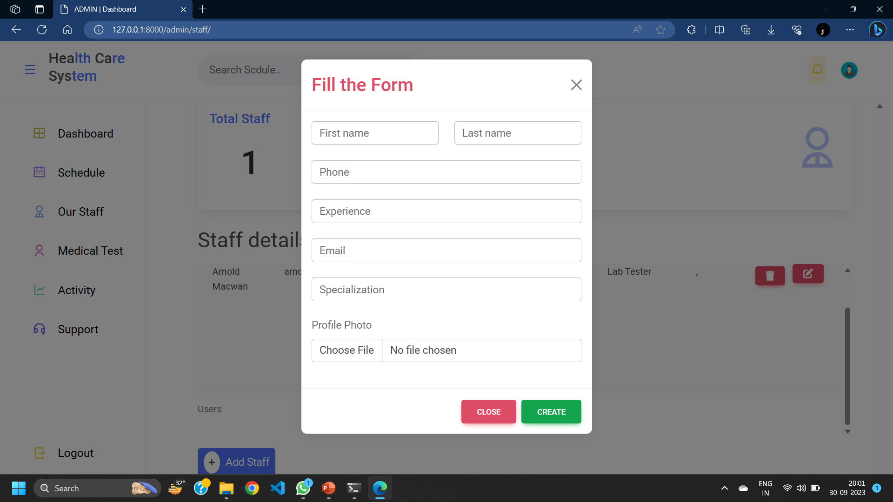

Slide 23
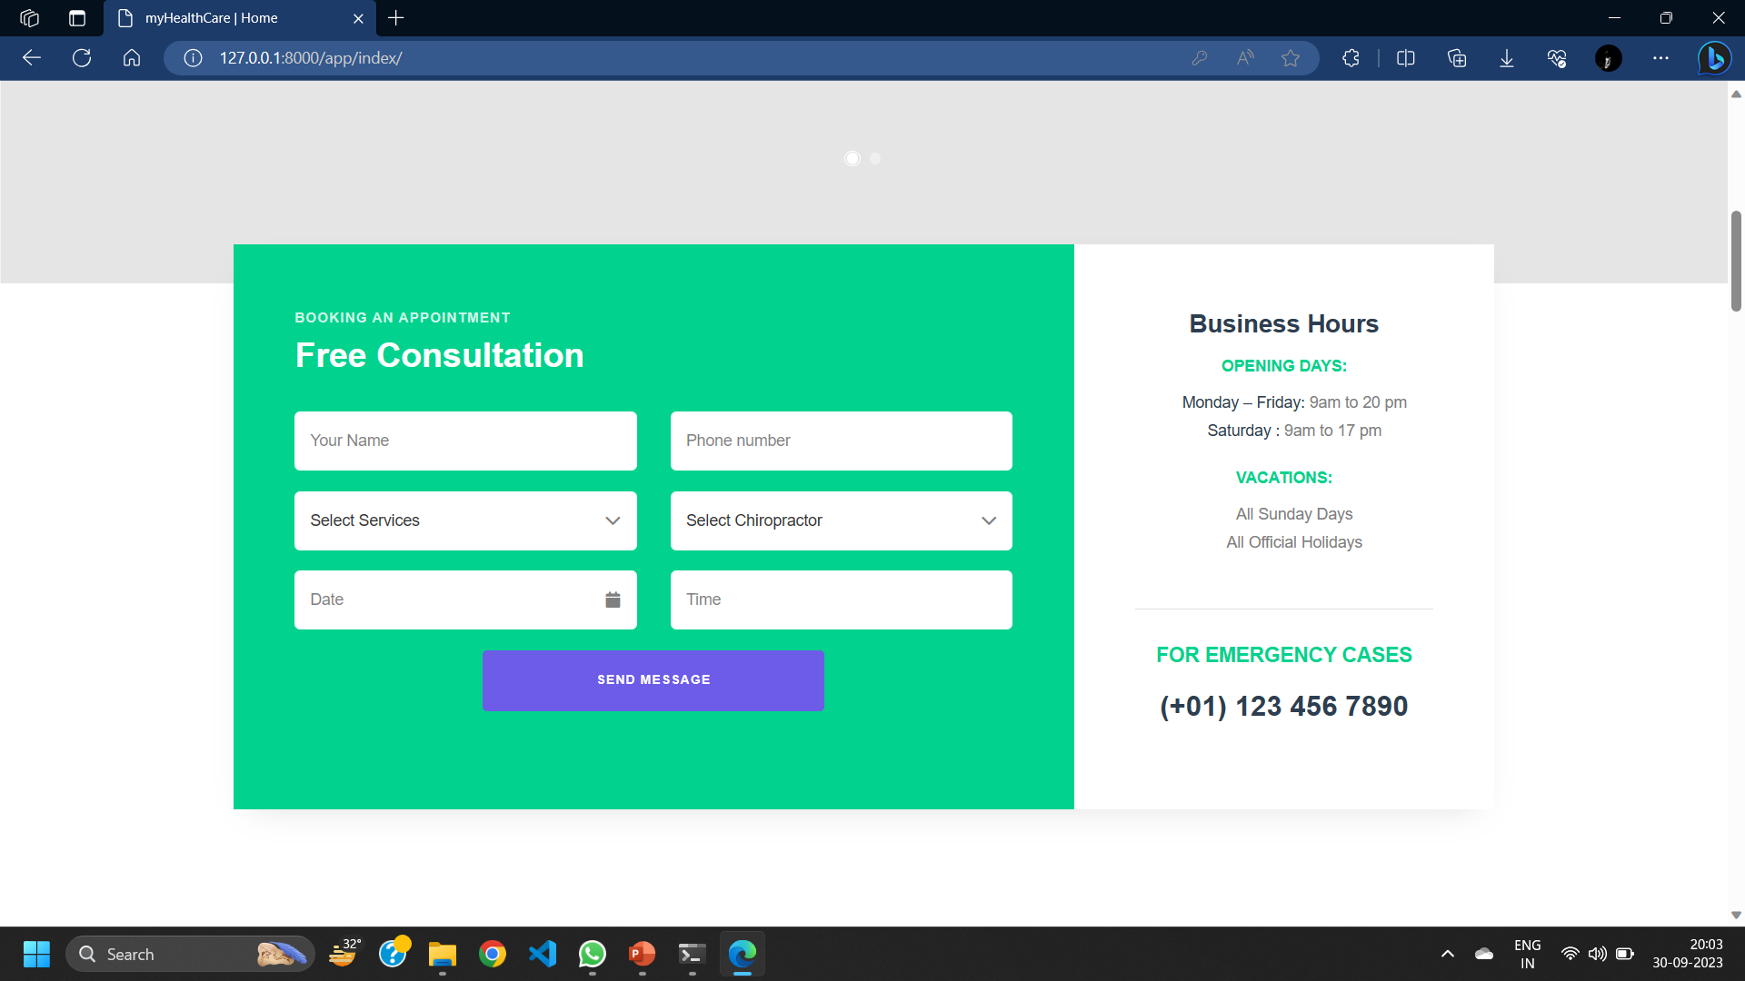

Slide 24
DATA DICTIONARY

Slide 25
User table
Field | Datatype | Constraints | Description | Sample
Id | Int(4) | primary key | Table id | 1
First name | Varchar2(25) | Not null | Firstname of the user | Arnold
Last name | Varchar2(25) | Not null | Lastname of the user | Macwan
Email | Varchar2(50) | Unique | Email of the user | abc@gmail.com
Password | Varchar2(10) | Not null | Password | abc@123
DOB | Date | Not null | Date of birth | 20-03-1969
Role | Varchar2(15) | Not null | Role of the user | Doctor
State | Varchar2(15) | Not null | State of user | Karnataka
City | Varchar2(15) | Not null | City of user | Pune
Pincode | Int(6) | Not null | Pincode of area | 382440
Apartment_no_nm | Varchar2(25) | Not null | Apartment no & name | B2 , harekrishna park
Userprofile | Varchar2(50) | Not null | Path of image of the user | pics/img.png

Slide 26
Staff_profile table
Field | Datatype | Constraints | Description | Sample
Id | Int(4) | primary key | Table id | 1
Qualification_doc | Varchar2(50) | Not null | Image path for Document of the qualification | doc/img.jpeg
Profilephoto | Varchar2(50) | Not null | Photo of the staff | pic/photo.png
Total_visit_done | Int(3) | Not null | No. of visit taken by staff | 12
Experience | Int(3) | Not null | Experience of the staff | 25 years
Joined_date | date | Not null | Date of joining | 20-09-2002
About | Varchar2(100) | Not null | About the staff | A supportive caretaker
Availability | Varchar2(10) | Not null | Status for staff Availability | Not available

Slide 27
Staff table
Field | Datatype | Constraints | Description | Sample
Id | Int(4) | primary key | Table id | 1
Firstname | Varchar2 | Not null | First name of staff | John
Lastname | Varchar2 | Not null | Last name of staff | Smith
Email | Varchar2 | Unique | Email of staff | abc@gmail.com
DOB | Date | Not null | Date of birth | 20-05-1996
Category | Varchar2 | Not null | Category of staff | Care taker

Slide 28
Services table
Field | Datatype | Constraints | Description | Sample
Id | Int(4) | primary key | Table id | 1
Name | Varchar2(25) | Not null | Title of the service | Lab test
Status | Varchar2(15) | Not null | Status of service | Pending
Cost | Decimal(4,2) | Not null | Cost of the service | 499/-

Slide 29
test table
Field | Datatype | Constraints | Description | Sample
Id | Int(4) | primary key | Table id | 1
Category | Int(4) | Not null | Category of test | Full body
Cost | Decimal(4,2) | Not null | Cost for the service | 699
Dur | Int(3) | Not null | Result duration of the test In hours | 36

Slide 30
Staff_history table
Field | Datatype | Constraints | Description | Sample
Id | Int(4) | primary key | Table id | 1
Title | Varchar2(20) | Not null | Job title of staff | Lab tester
Perfomance_rating | Int(2) | Not null | Rating of staff based on user review | 3
Staffid | Int(4) | Foreign key references staff table | Staff id | 1
Status | Varchar2(15) | Not null | Status of the staff | Part-time
Pending_service | Int(3) | Not null | Pending services allocated to staff | 3
Completed_services | Int(3) | Not null | Completed services by staff | 5

Slide 31
Homevisit table
Field | Datatype | Constraints | Description | Sample
Id | Int(4) | primary key | Table id | 1
Userid | Int(4) | Foreign key references user table | Id of the user | 2
Date | Date | Not null | Date of the visit | 15-10-2023
Status | Varchar2(10) | Not null | Status of the visit | Pending
Staffid | Int(4) | Foreign key references staff table | Visit allocate to the staff | 2
Reason | Varchar2(25) | Not null | Reason for visit | Blood report

Slide 32
Appointment table
Field | Datatype | Constraints | Description | Sample
Id | Int(4) | primary key | Table id | 1
Email | Varchar2(50) | Unique | Email of the logged in user | abc@gmail.com
Date | Date | Not null | Date of the visit | 15-10-2023
Status | Varchar2(10) | Not null | Status of the visit | Pending
Type | Varchar2(15) | Not null | Type of the service | Lab test

Slide 33
patientprofile table
Field | Datatype | Constraints | Description | Sample
Id | Int(4) | primary key | Table id | 1
Userid | Int(4) | Foreign key references user table | Id of the user | 2
Membership_holder | Boolean | Not null | If the user is membership holder | TRUE
no_of_visits | Int(3) | Not null | No. of visits to patient | 5
Height | Int(4) | Not null | Height of the patient | 165cm
Weight | Int(4) | Not null | Weight of the patient | 56kg
Blood_group | Varchar2(4) | Not null | Blood group of the user | O+
BMI | Int(5) | Not null | Body-mass index of the user | 23.6%
Date_joined | Date | Not null | Date of the joining organization | 20-03-2005

Slide 34
Billing table
Field | Datatype | Constraints | Description | Sample
Id | Int(4) | primary key | Table id | 1
Userid | Int(4) | Foreign key references user table | Id of the user | 2
Date | Date | Not null | Date of the bill | 20-04-2024
Discount | Decimal(6,2) | Not null | Discount price on bill | 2500/-
Total_amount | Decimal(6,2) | Not null | Amount of the bill | 9980/-
Payment_id | Int(10) | Foreign key references payment table | Payment id | 15002693

Slide 35
Medical_history table
Field | Datatype | Constraints | Description | Sample
Id | Int(4) | primary key | Table id | 1
Userid | Int(4) | Foreign key references user table | Id of the user | 2
Condition | Varchar2(15) | Not null | Medical condition of the patient | Critical
Patient_profile_id | Int(4) | Foreign key references patientprofile table | Id of the patient profile table | 5
Status | Varchar2(15) | Not null | Status of the medical condition | Not active
Last_visit_take | Date | Not null | Date of last visit taken by patient | 12-05-2003

Slide 36
Premium-user table
Field | Datatype | Constraints | Description | Sample
Id | Int(4) | primary key | Table id | 1
Userid | Int(4) | Foreign key references user table | Id of the user | 11
Startdate | Date | Not null | Date of buying the premium | 12-12-2022
Expirydate | Date | Not null | Date of expiry of premium | 10-11-2023
Renewal_option | Varchar(10) | Not null | Option to renew the premium | Manual

Slide 37
Feedback table
Field | Datatype | Constraints | Description | Sample
Id | Int(4) | primary key | Table id | 1
Userid | Int(4) | Foreign key references user table | Id of the user | 2
Date | Date | Not null | Date of the feedback received | 20-04-2024
Message | Varchar2(250) | Not null | Message description for feedback | It was good

Slide 38
Blogs table
Field | Datatype | Constraints | Description | Sample
Id | Int(4) | primary key | Table id | 1
Userid | Int(4) | Foreign key references user table | Id of the user | 2
Date | Date | Not null | Date of the feedback received | 20-04-2024
Message | Varchar2(250) | Not null | Message description | It was good

Slide 39

AGILE DOCUMENTATION

Slide 40
Project charter
Project name | Healthcare webApplication
Guide | Dr Jignesh Doshi
Project expected start date | 14-08-2023
Project expected end date | 30-11-2023
Project Scope | Integration of Booking health service Custom Admin UI deployment Report and documentation download Safe & secure storing patient information and medical history
Project mission | Our mission is to provide such a platform so that every customer using the system will get the enhanced online service for their health accordingly their customization.
Project vision | Our vision is to reach every person who is not able to take even primary healthcare services and provide them services at doorstep by using their phones.

Slide 41
User Story

Slide 42
Sr. | As a <user> | Want to <task> | So that <goal>
1 | Admin | Login | I can manage flow and activities as administrator
2 | Admin | Manage users / patient | I can control user activities & account related issues
3 | Admin | Manage staff | I can control & review staff activities
4 | Admin | Confirm home-visit request | I can verify & accept user’s request for home visit
5 | Admin | Allocate service to staff | Staff can handle service for patient
6 | Admin | Generate report | Insights can be visualized
7 | Admin | Manage lab test | Let the Lab tester know about it & patients can use
8 | Admin | Manage services | User can request for service provider accordingly
9 | Admin | Access medical history | Health reports can be made
10 | Admin | Post a blog | Article & blogs can be read
11 | Admin | Logout | No one can access system except me

Slide 43
Sr. | As a <user> | I Want to <task> | So that <goal>
1 | Patient | Login | I can use the system as existing user
2 | Patient | Sign up | I can use the system as new user
3 | Patient | Manage profile | I can edit or delete my profile account & review profile
4 | Patient | Buy premium | I can use extra benefits of system
5 | Patient | Search service provider | I can spectate particular provider
6 | Patient | Browse services | I can search & view services accordingly
7 | Patient | Give feedback | I can give feedback of system & enhancement can be done

Slide 44
Sr. | As a <user> | I Want to <task> | So that <goal>
8 | Patient | Request home visit | I can book a home visit
9 | Patient | View medical history | I can review health report & history
10 | Patient | Get service | I can book service according to need
12 | Patient | Cancel home visit | I can remove appointment for home visit If it isn’t needed
13 | Patient | Make payment | I can get confirmed service
14 | Patient | Subscribe newsletter | I can quickly get update of new news & events
15 | Patient | Download reports | I can soft copy of medical history
16 | Patient | Print bill | I can get a copy of payments
17 | Patient | Logout | No one can access my data

Slide 45
Sr. | As a <user> | I Want to <task> | So that <goal>
1 | Staff | Sign up | I can join system as service provider
2 | Staff | Login | I can use system as existing user
3 | Staff | Manage patient profile | I can update patient profile after providing service
4 | Staff | Manage profile | I can edit or remove personal profile from system
5 | Staff | Access patient medical history | I can provide service accordingly
6 | Staff | Post blog | I can publish articles
7 | Staff | Update Availability | I can take leave accordingly
8 | Staff | Manage tasks/appointments | I can review or update all pending tasks allocated
9 | Staff | Delete account | I can remove my self as a service provider from system
10 | Staff | Logout | No one can access my data

Slide 46
Project RoadMap

Slide 47
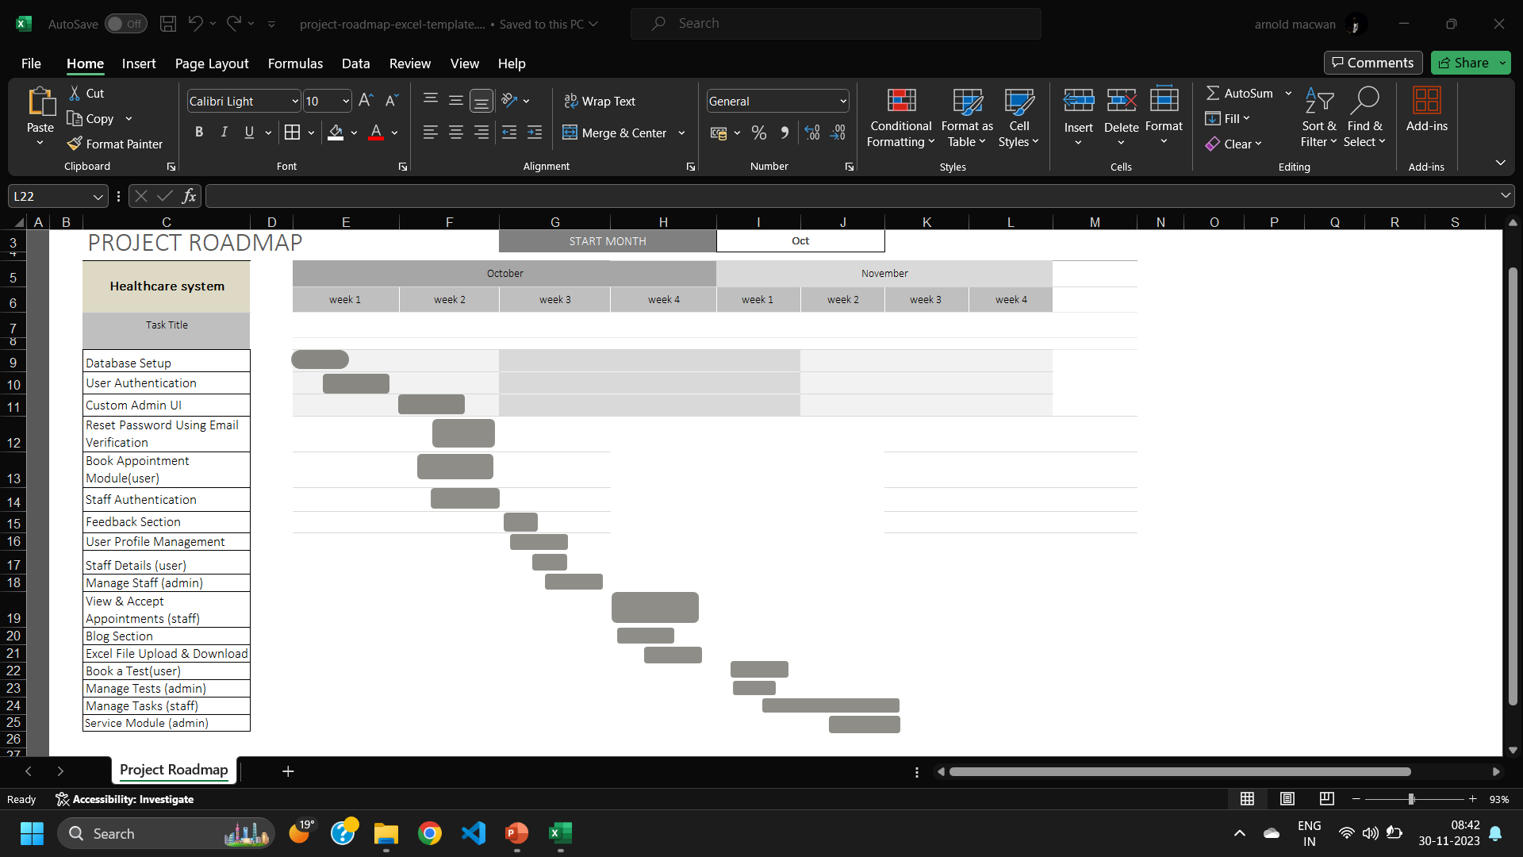

Slide 48
Sprint BackLog

Slide 49
Id # | Task / Module | Assigned to | Status | Estimated time(hours) | Story points
1 | Authentication | Arnold | Completed | 3 | 6
2 | Password Reset & verification | Arnold | Completed | 2 | 4
3 | Appointment Module | Dharmik | Completed | 8 | 10
4 | Service Module | Dharmik | Completed | 6 | 8
5 | Test Module | Arnold | Completed | 2 | 4
6 | Profile management | Tirth | Completed | 4 | 8
7 | Download Data Files | Tirth | Completed | 4 | 8
8 | Book Home Visit | Arnold | Completed | 2 | 4
9 | Manage Tasks (staff) | Arnold | Completed | 8 | 10
10 | Blog Section | Tirth | Completed | 3 | 6
11 | Feedback Section | Dharmik | Completed | 3 | 6

Slide 50
Release plan

Slide 51
Task | Start date | End date | Status | Release date
Database connection & setup | 02-10-2023 | 03-10-2023 | Released | 04-10-2023
User authentication | 04-10-2023 | 06-10-2023 | Released | 06-10-2023
Custom Admin UI | 08-10-2023 | 10-10-2023 | Released | 11-10-2023
Reset password with email | 11-10-2023 | 12-10-2023 | Released | 13-10-2023
Book Appointment module (user) | 12-10-2023 | 13-10-2023 | Released | 13-10-2023
Staff Authentication | 15-10-2023 | 17-10-2023 | Released | 19-10-2023
Feedback section | 16-10-2023 | 17-10-2023 | Released | 17-10-2023
User Profile Management | 16-10-2023 | 18-10-2023 | Released | 19-10-2023

Slide 52
Task | Start date | End date | Status | Release date
Staff details(user) | 17-10-2023 | 17-10-2023 | Released | 17-10-2023
Manage staff (admin) | 22-10-2023 | 25-10-2023 | Released | 25-10-2023
View & accept appointments (staff) | 18-10-2023 | 23-10-2023 | Released | 23-10-2023
Blog Section | 23-10-2023 | 25-10-2023 | Released | 25-10-2023
File/Data download (Excel) | 23-10-2023 | 23-10-2023 | Released | 24-10-2023

Slide 53
Test plan

Slide 54
Project Name | Healthcare System | Browser: | Chrome
Tested on: | 30-11-2023 | Device: | Ryzen 5 Laptop
Test# | Action | Expected Result | Actual Result | Status
1 | User Authentication | Redirect to home screen | Redirect to home screen | Pass
2 | Staff Authentication | Redirect to staff home screen | Redirect to staff home screen | Pass
3 | Admin Authentication | Redirect to admin screen | Redirect to admin screen | Pass
4 | Reset password using Email | Password reset by sending email | Password reset by sending email | Pass
5 | Feedback section | Feedbacks should be displayed on user screen | Feedbacks is displayed on user screen | Pass
6 | Book Appointment | Appointment should be booked | Appointment is booked | Pass
7 | View and accept Appointment (staff) | Appointment should be view and manage by staff | Appointment is viewed but not getting manage | FAIL
8 | Edit Profile (user) | Profile should be Update | Profile is being updated | Pass
9 | Blog Section | Blogs Should be posted and displayed | Blogs are being posted but not getting read | FAIL

Slide 55
Sprint Burn chart

Slide 57
Proposed Enhancement
System is focusing on resolving current issues and enhancing functionality.
Improvements include data security, efficient analytics using machine learning, and integrating telemedicine.
Access control and advanced encryption techniques can protect patient data.
System is also looking for mobile applications which can help monitor patients remotely and communicate with them in real time.

Slide 58
Conclusion
A healthcare management system is essential for improving patient care, operational effectiveness, data security, and regulatory compliance. It promotes the implementation of cutting-edge technologies, facilitates the seamless sharing of patient data, and helps with cost management.

Slide 59
THANK YOU

